Slide 1
Lyme Disease Forecasting Contest Kick-Off
Josh Tyler
31st March 2025

Slide 2



Outline
Introduction from SPHERE-PPL Team
Contest, Timeline & Communication
Getting Started

Slide 3








Makkunda Sharma
Ettie Unwin
Josh Tyler
Josh Tyler
Seth Flaxman
Megan Ruffle
Josh Tyler
Josh Tyler
Nathan Clark
Will Pearse

Slide 4
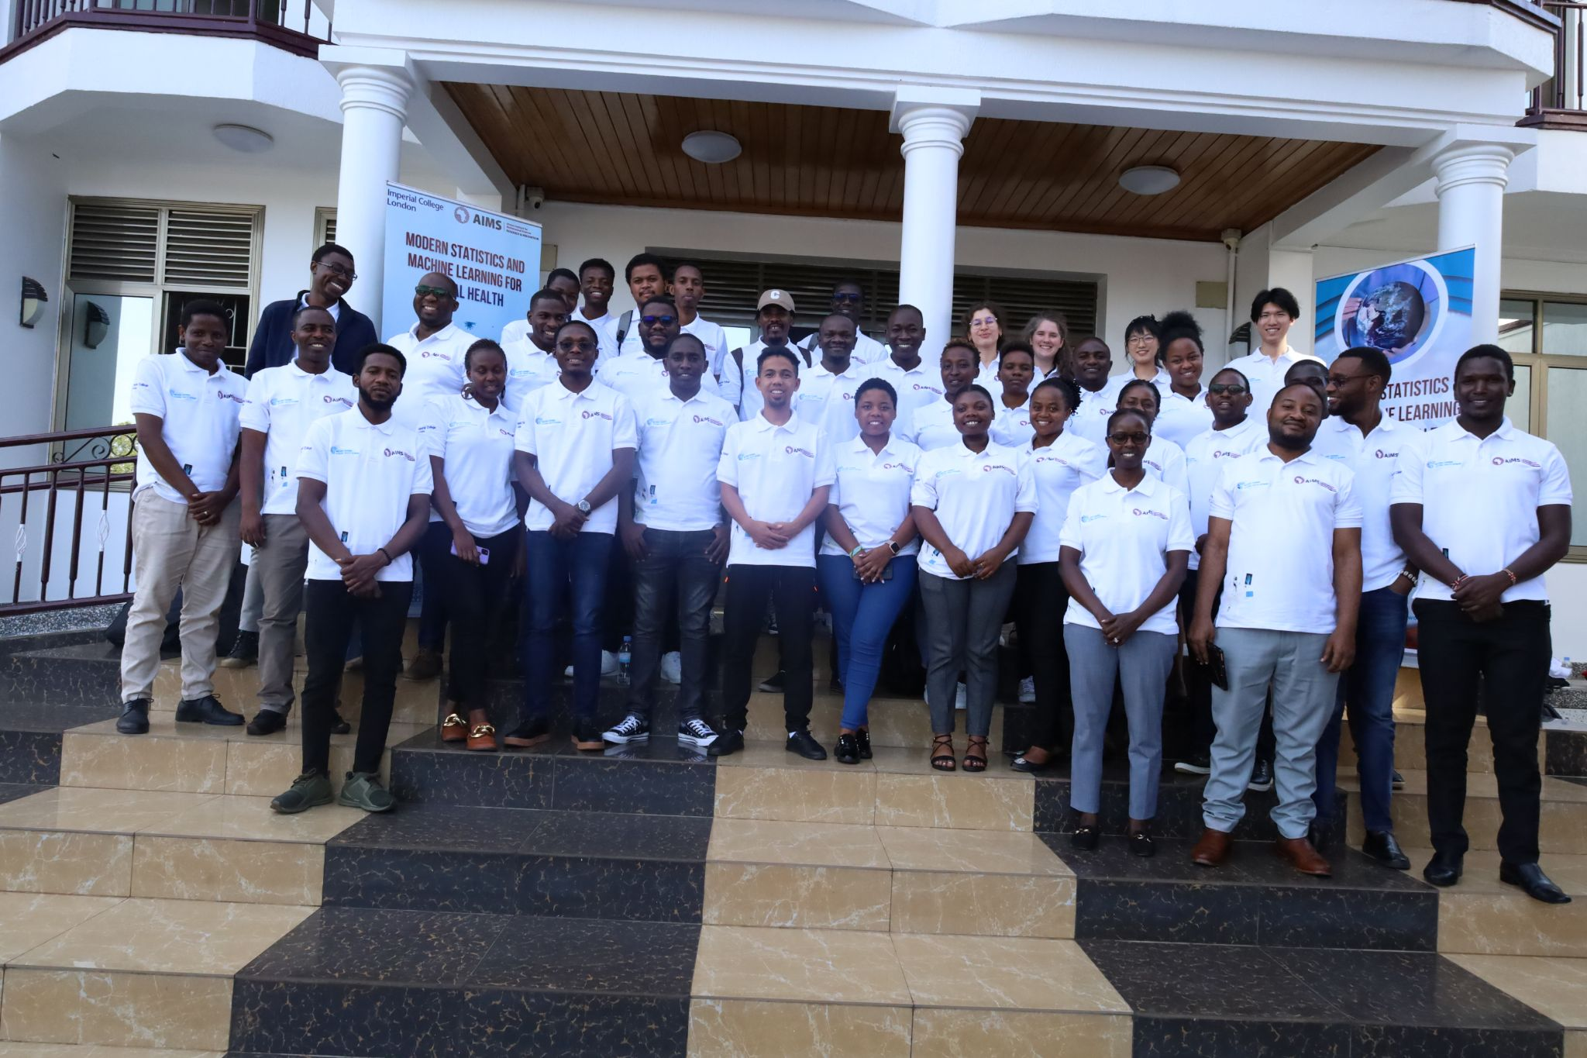
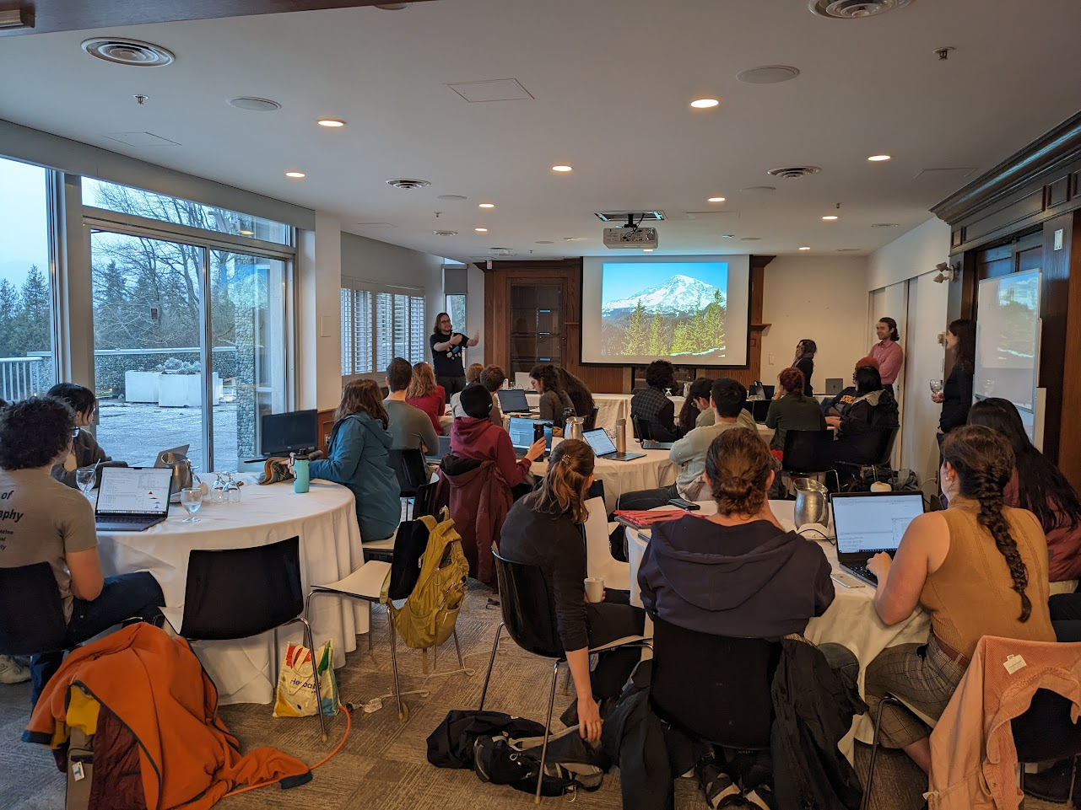

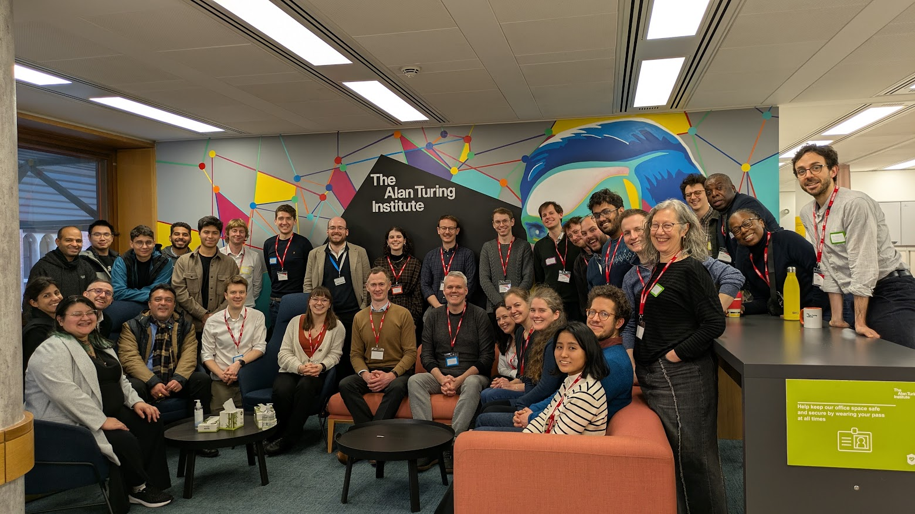
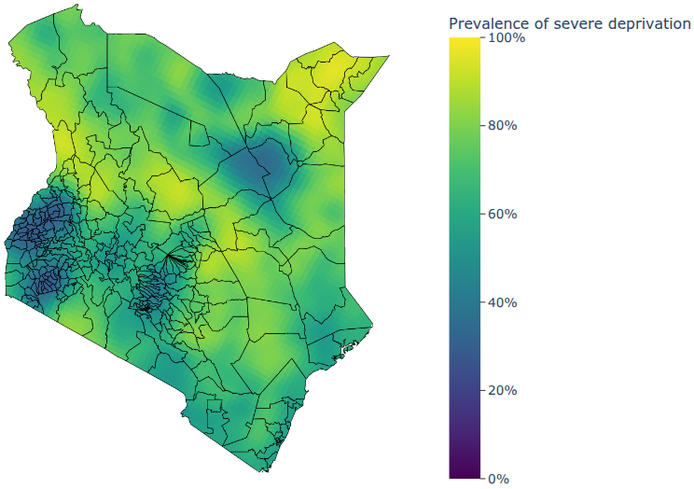
What is SPHERE-PPL doing?
Contests
Training
Networking
Research

Slide 5
Vector-Borne Diseases
A vector-borne disease is an illness transmitted to humans or animals by living organisms, known as vectors, like mosquitoes, ticks, and fleas, that carry pathogens (bacteria, viruses, or parasites).
VBDs are prevalent across the globe with 80% of world’s population at risk of one or more vectors.
Data taken from WHO & NHS

Slide 6


VBD Hub
The One Health Vector-Borne Diseases Hub is a research hub for data sharing, exploration, and collaboration on vector-borne diseases both in the UK and globally.
https://vbdhub.org/

Slide 7
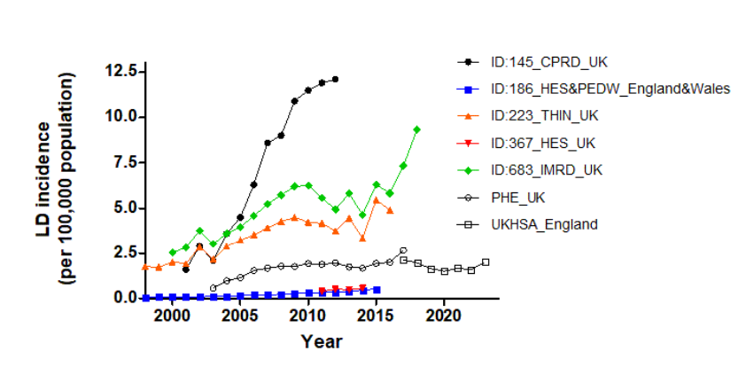
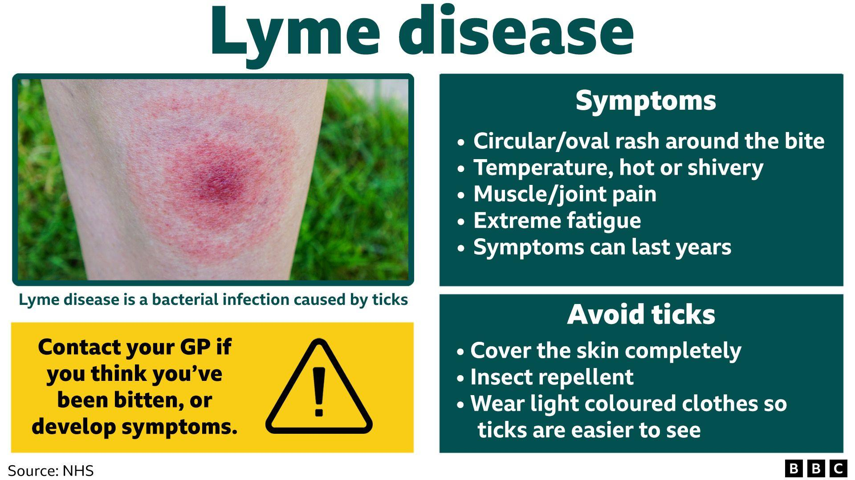
Lyme Disease
Lyme Disease is the most prevalent VBD in the UK, USA & most of Western Europe
The Bacteria that causes the disease, Borrelia burgdorferi, is transmitted to humans through the bite of the black-legged tick
In the UK, it is the only endemic VBD and incidence rates have been rising steadily, tracked through routine surveillance
Data taken from WHO & NHS

Slide 8
Contest Outputs
For this contest, we are looking to forecast Lyme Disease Cases at a range of geographical scales for 2023 & 2024 AND a narrative report describing how you got the results!
There are 3 columns to be filled for the forecast:
Incidence (Mean)
Incidence (Lower 95th Confidence Interval)
Incidence (Upper 95th Confidence Interval)
Incidence rates should be given as cases per 100,000 population.

Slide 9

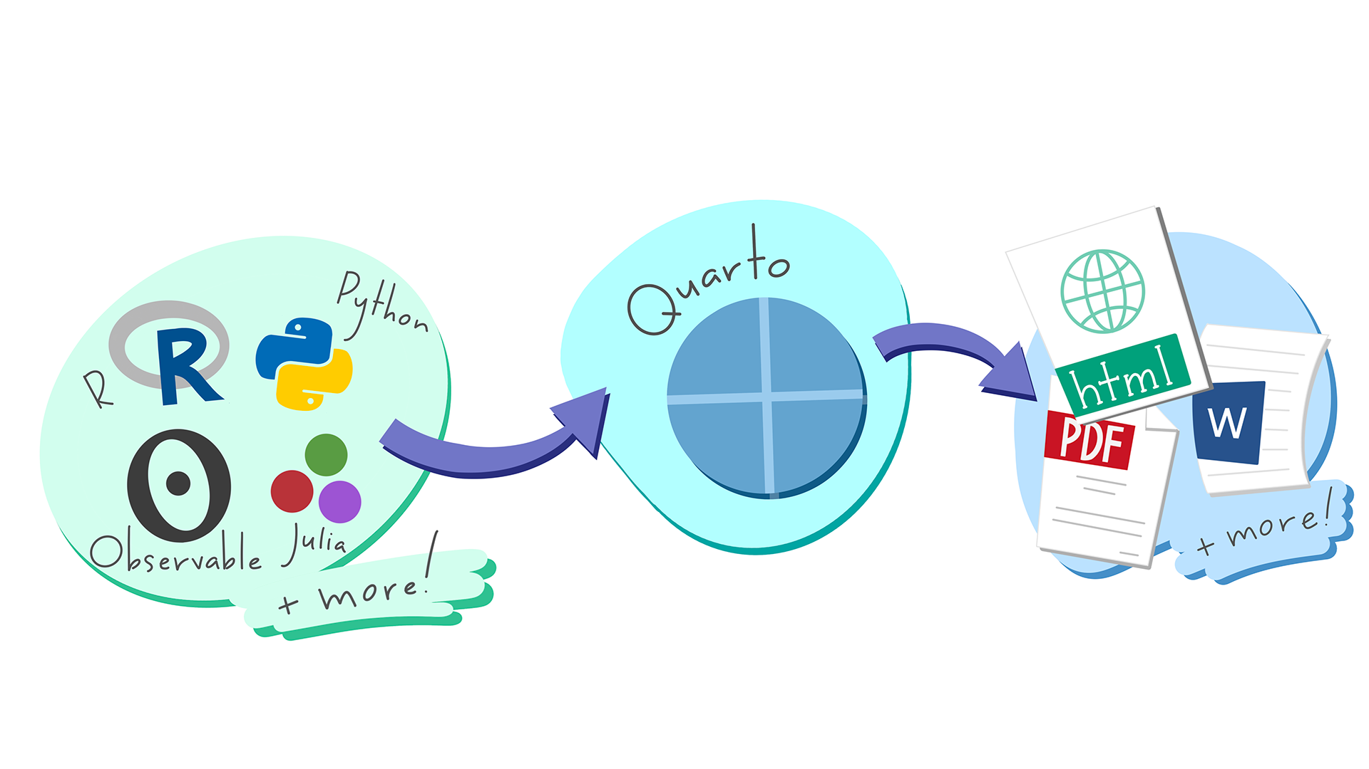
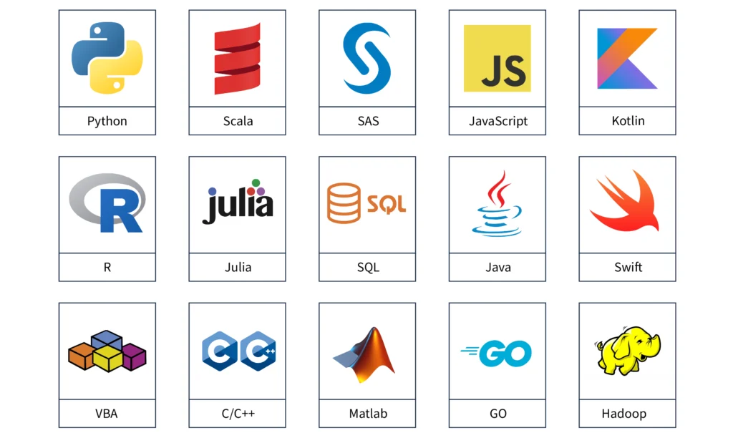
Contest Rules
Any coding languages are allowed but all analyses must be reproducible by the panel.
All entries must be loaded into a public Github repo.
All entries must follow the submission formats outlined below.
All entries must include a max 1000 word report to accompany the forecast analyses. This can be as a separate PDF/hmtl or incorporated into a quarto/jupyter notebook.

Slide 10
Contest Winners
For this contest, there are 2 prize categories:
Most Accurate Estimates (as measured by RSME)
Most Novel Report (e.g. storytelling, figures, insights)
The winners will be selected by the SPHERE-PPL Team and will be invited to present their forecasts at the next Annual Meeting, with travel supported by the project (within funding limits).

Slide 11
Contest Timeline
Monday 31st March
Contest Kick-Off Meeting & Contest Opens
Throughout April & May
Drop-in sessions for contest advice & guidance (run by SPHERE-PPL Team)
Friday 30th May
Contest Closes
Throughout June
Entries will be aggregated into a single output report and winners will be chosen.

Slide 12

Communication
We have a SPHERE-PPL Zulip group (akin to Teams or Slack) where we will be available to answer questions and interact with the community.
Please also use it for communicating within your own teams!
Join Here!

Slide 13
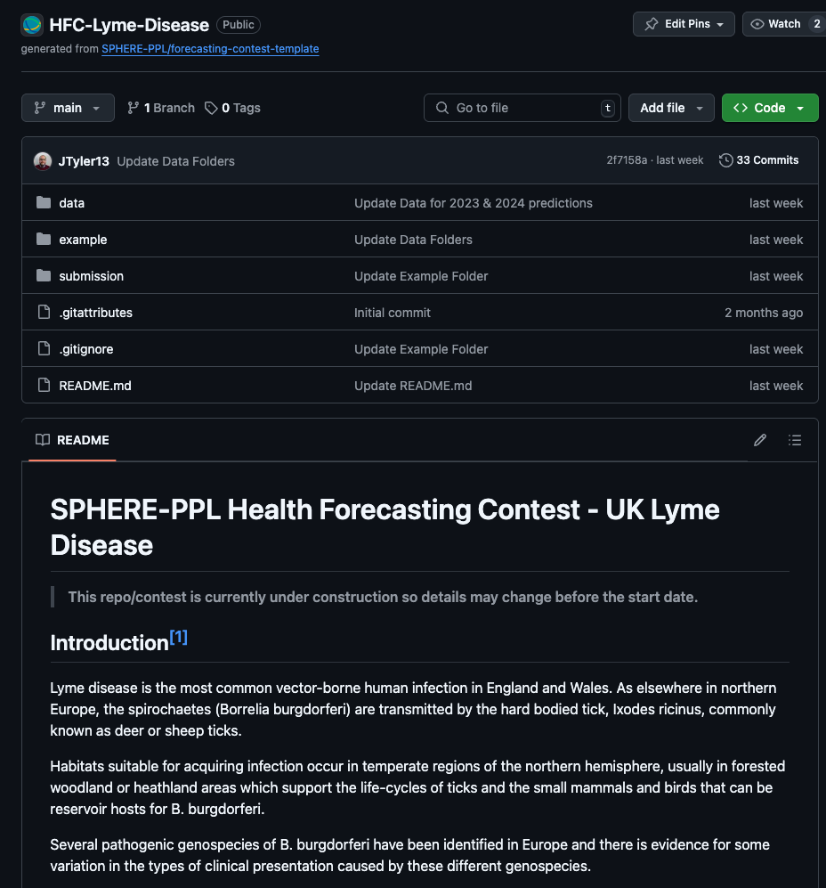
Getting Started
Main Link: Lyme Disease Forecasting Contest
Resources
Overview & Quick-Start Videos
Example Contest – Mpox

Slide 14
Thanks For Joining!
Get more information at our website: www.sphere-ppl.org
Email us at: info@sphere-ppl.org

